Slide 1
Objectives
Be familiar with the naming and abbreviations of the automation control system
To obtain knowledge about the different hardware units in the system and how they are connected
To learn how to monitor the status of the hardware units by using System Configuration.
Notes:
25/11/09
Objectives
Be familiar with the naming and abbreviations of the automation control system
To obtain knowledge about the different hardware units in the system and how they are connected
To learn how to monitor the status of the hardware units by using
System Status image and Station Explorer view on the operator station

Slide 2
K-Chief 600 (IVCS )
The control system is used in a wide range of applications:
    Power management system
    Machinery
    Ballast and Cargo
    Extended alarm system
The system integrate with:
    Fire system
    PMS
    WHRS
    Propulsion
    Thruster Control system
    Vessel Performance
    Bearing Wear
The control system uses K-Base SW principles on MS Windows 7 OS platform
Notes:
25/11/09
K-Chief 600
Go thru the different KM products and explain approximately what they do.
Explain how we do/can integrate with K-Chief 600.
Explain that K-Base is an application and Windows is the platform.

Slide 3
Main functions of the system
Collect data’s from field
Present values on the monitor
Handle alarms
Manual control
Automatic control
Logging of data
Reporting
Trends
System configuration
Notes:
25/11/09
Main functions of the system
This items is going to be covered in more detail later in the course.

Slide 4
K-Chief 600
K-Chief 600 characteristics:
  Distributed system
  Communication via dual LAN and CAN network
  Stations with specific tasks: e.g. Monitoring and Control
Notes:
25/11/09
K-Chief 600
Distributed system means that we have all the DPU’s handling all the IO, out in the process.
We use LAN A & B between OS, and CAN A & B as the process network.
Example: Wheelhouse OS may only have monitoring.

Slide 5
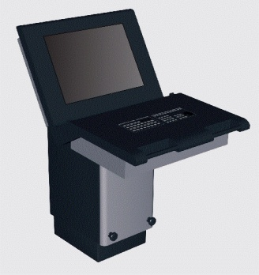
Overview K-Chief 600 LAN and Global CAN-1
OS 1
OS 2
Network A
LAN
Switch
Network B
Prosess network A/B
SCU
Global CAN Net A
Global CAN B
SCU
SCU
Notes:
25/11/09
K-Chief 600 System Architecture
Explain the Ethernet and Process CAN network.
CAN A starts on the first SCU, CAN 2 starts on the last SCU and ends at the first one with a resistor 120ohm.

Slide 6
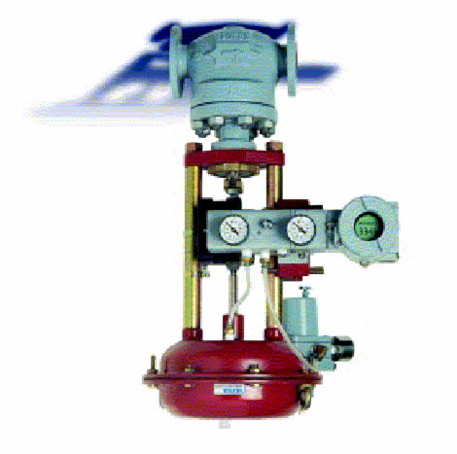
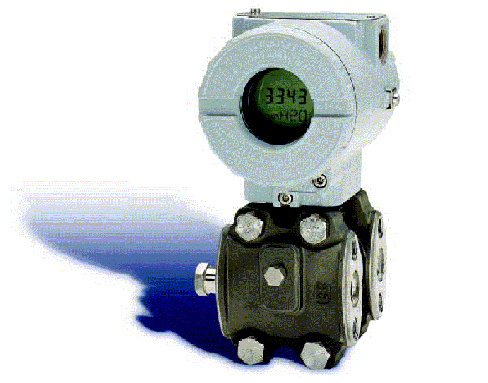
Overview K-Chief 600 Local CAN-1
SCU
SCU
Local
CAN A
Local
CAN B
DPU
Sensors and actuators
DPU
Notes:
Global and Local CAN
Redundant local CAN in a cabinet.
Also local CAN are redundant with A & B net.
Note the dosts as end termination.
25/11/09

Slide 7
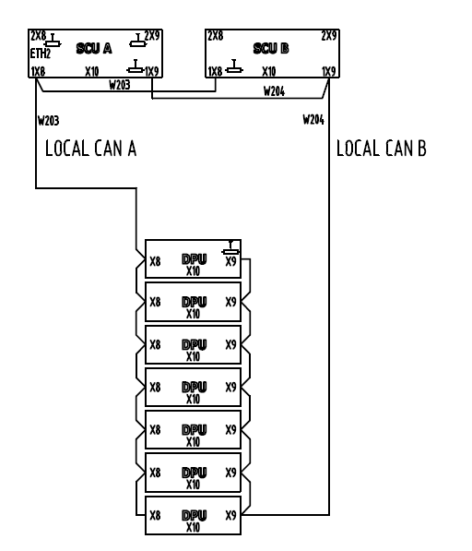
Overview K-Chief 600 Local CAN-2

Slide 8
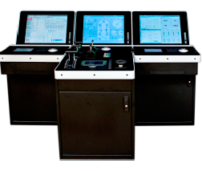
Operator station
Main interface between the operator and the process
Monitor
The operators “eye” into the process
Panels
Specific panels for simplified operator communication
HP – MP8300 type approved computer
Notes:
25/11/09
Operator station

Slide 9
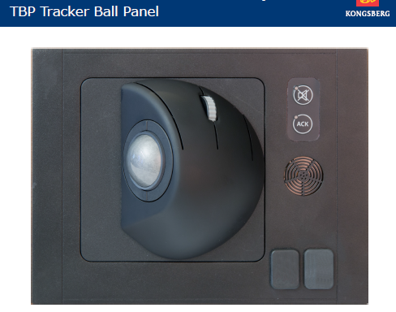
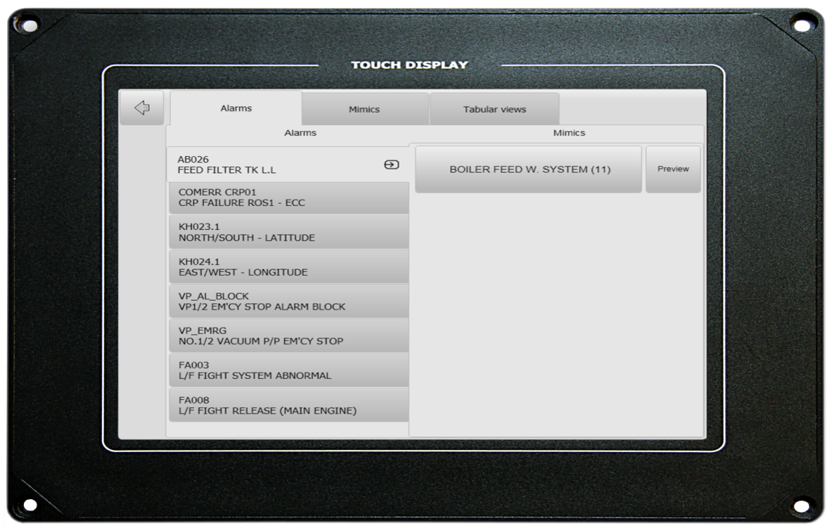
OS Panels
TCP
TBP
Notes:
25/11/09
OS Panels
There is two different CRP panels
Explain the difference and functionality and that they have to order right version if it need to be changed.
They cannot be mixed without some configuration on the OS file system.

Slide 10
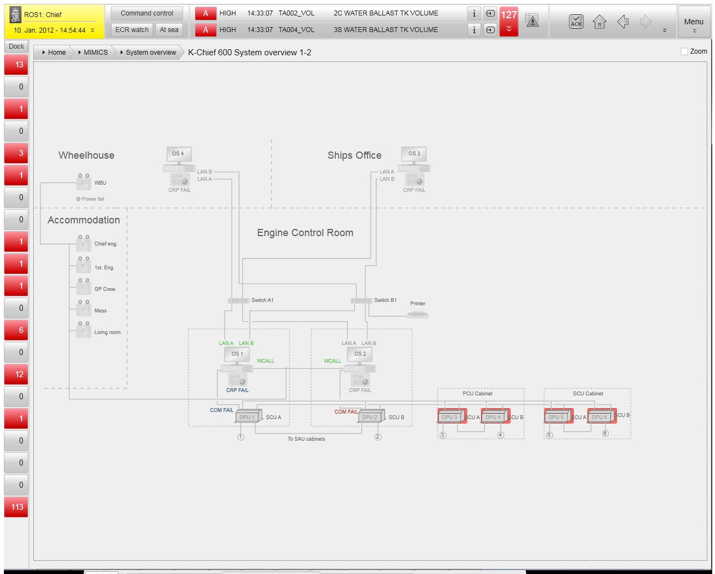
K-Chief 600 System Overview 1-2
Notes:
25/11/09
K-Chief 600 System Overview 1-2
Explain that system overview is an interactive mimic.
You will se “com” failure as an red square around a DPU.
By clicking on a DPU, you will have an overview of all the channels and status.

Slide 11
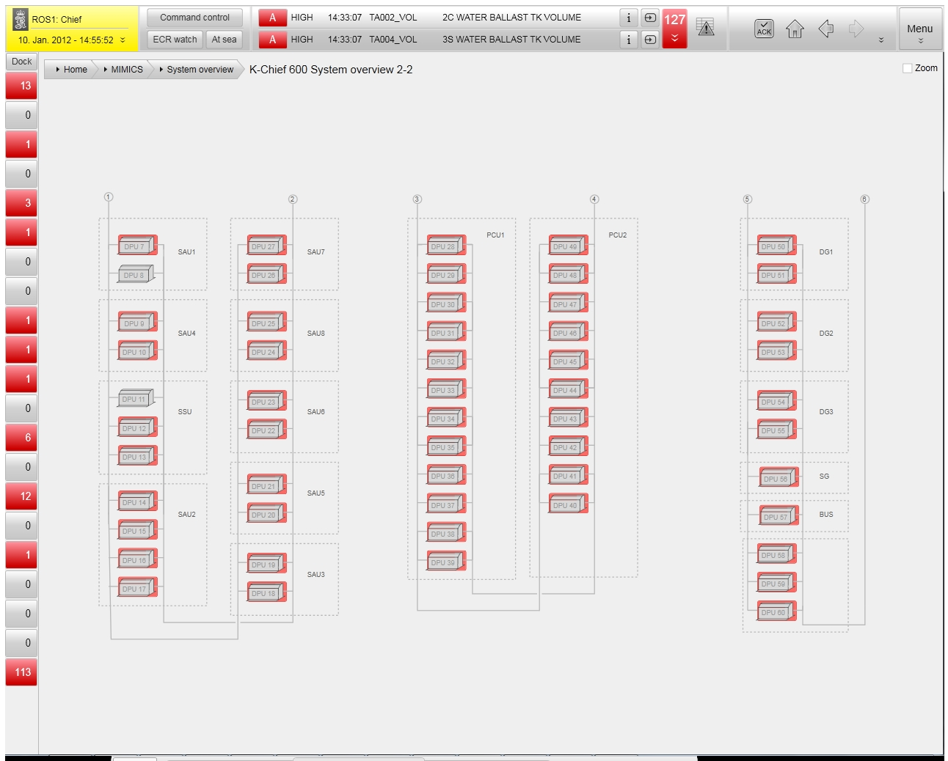
K-Chief 600 System Overview 2-2
Notes:
25/11/09
K-Chief 600 System Overview 2-2

Slide 12
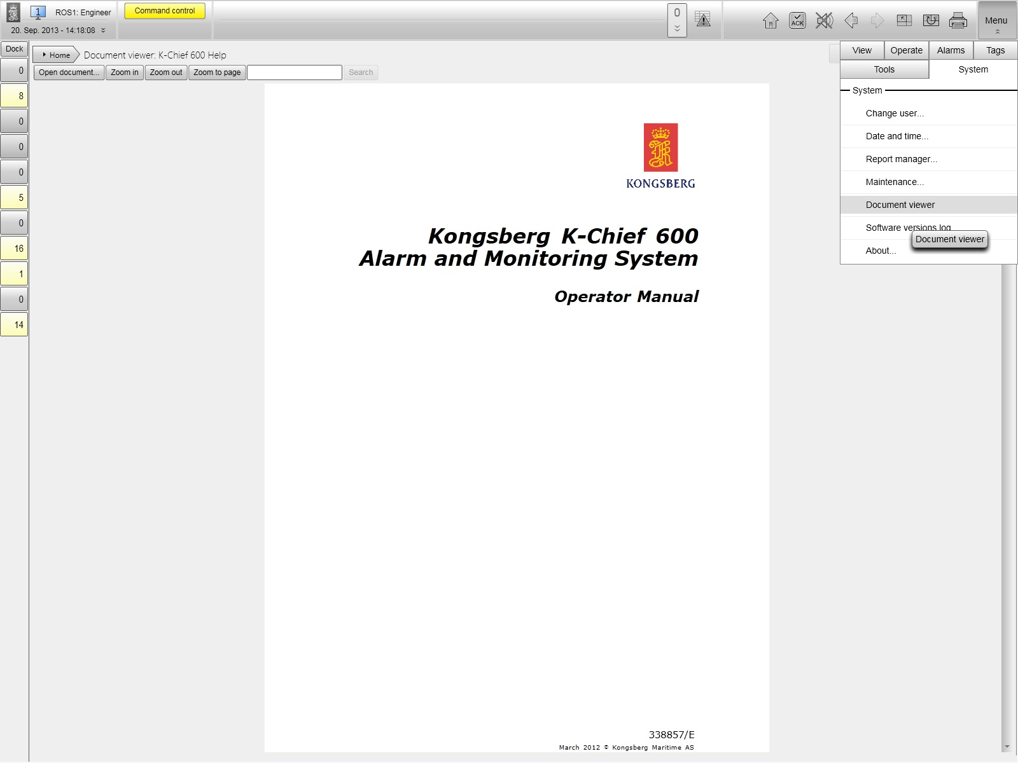
Notes:
Documentation (dwgs and manuals) included in system
25/11/09

Slide 13
Next
System config dwg UASC
Notes:
25/11/09

